Slide 1
BUILDING LONDON: ROMANS, WREN AND LONDON TODAY London Maps through Time
The following images are provided for teachers to use in class, after their KS2 Learning day.
Please note that images may only be used for education purposes and no republication allowed.
Copyright information is provided in notes below each slide.

Slide 2
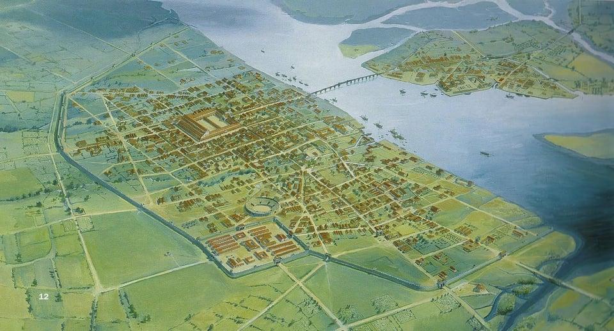
Illustration of Londinium, the Roman City and Fort, in AD 200 © MOLA
Notes:
Illustration of the Roman City and fort
Creator: Peter Froste, 1996
Londinium - Roman London in AD 200
© MOLA (Museum of London Archaeology)
Source: https://artsandculture.google.com/incognito/asset/illustration-of-the-roman-city-and-fort-peter-froste/ygFglPym3qyxWw?hl=en
This illustration shows an artists impression of how Londinium may have looked in AD 200, based on archaeological evidence for the road plan and some key buildings.

Slide 3
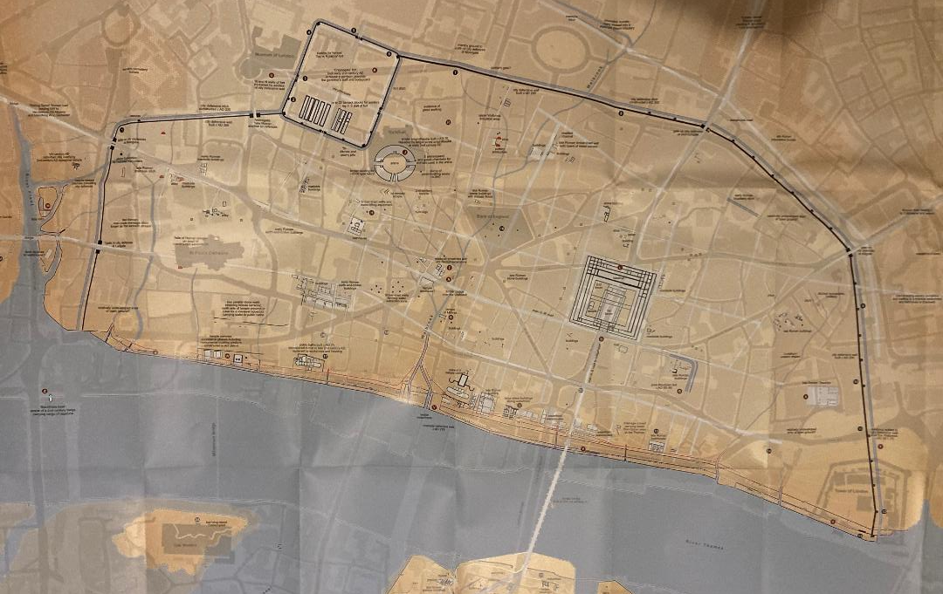
Londinium map overlayed onto the modern street plan. © MOLA
Notes:
Map of Roman London imposed on a modern street plan
Creator: Museum of London Archaeology
© MOLA (Museum of London Archaeology)
Source: https://www.mola.org.uk/londinium-new-map-and-guide-roman-london
This map graphically presents MOLA’s most up-to-date knowledge of that lost world: the Roman city’s topography, plan and appearance, including its roads, waterfronts, public buildings, houses and defences. Roman remains are accurately located and superimposed on the modern street plan, with visible features indicated.
Londinium was founded by the Romans nearly 2000 years ago, shortly before AD 50. Roman London was built on a ‘green-field’ site which is now occupied by the City of London and north Southwark. The early frontier town was an immediate success and was occupied for almost four centuries. For much of this time Londinium thrived, despite disasters that included destruction at the hands of Boudicca, widespread fires, economic problems and political crises. Although abandoned in the 5th century, Londinium’s layout determined the siting and shape of the medieval City of London and hence the modern metropolis. Over the centuries London’s ground surface has risen inexorably and as a result Roman streets and buildings lie buried up to 7m below the modern street level.

Slide 4
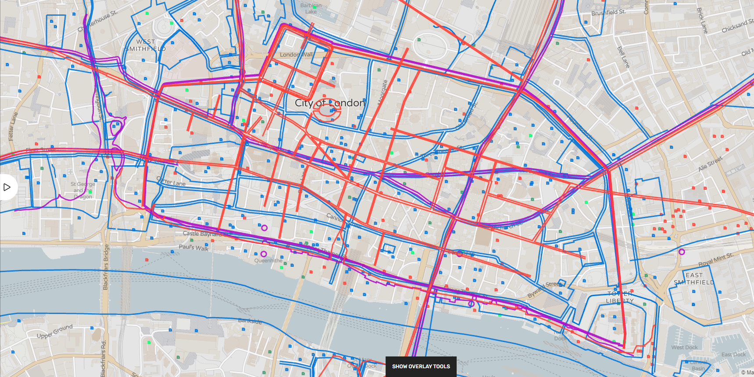
Londinium © www.layersoflondon.org .
Notes:
Londinium
Creator: Layers of London
© Layers of London
Source: www.layersoflondon.org
In this map the Roman walled city can be seen (overlaying a map of modern London). The bridge, main streets, fort, forum and amphitheatre are visible within the layout.
Layers of London is an excellent online resource for exploring different maps of London. It is a free resource – providing online layers of maps of London through time, which can be faded in or out to show layers of how the city has changed across time. Pins provide information on key buildings.

Slide 5
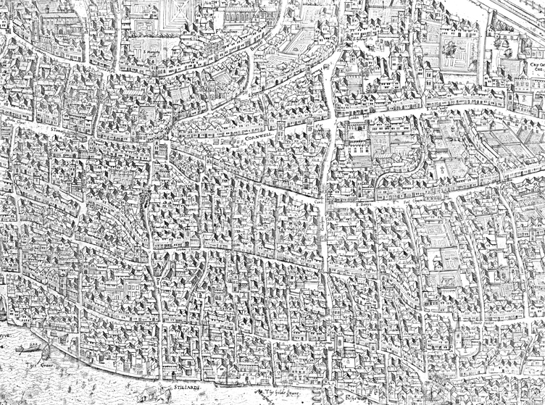
The Copperplate Map of London: 1559. © Museum of London
Notes:
The Copperplate Map of London; The Assumption of the Virgin
© Museum of London
ID: 85.471
Source: https://www.museumoflondon.org.uk/Resources/learning/targettudors/city/object.html
https://collections.museumoflondon.org.uk/online/object/104949.html
This is one of a set of copper printing plates that were used to produce a very detailed map of London – the earliest known map of the city.
This plate shows the eastern side of the City of London. It shows how crowded the City was. Various London streets can be seen, such as Cornhill and Gracechurch Street. As well as all the houses, streets, gardens and churches, you can see other details of daily life such as the water conduit at Cornhill. This was a public water pump or well where people would collect water everyday for use at home. If you had enough money, you could pay water bearers to provide you with water – you can see their tankards lined up by the well. They would walk round from house to house selling water everyday.
How was the map made?
Maps were printed from engraved copper plates. First an artist made a drawing. Then an engraver copied it by cutting lines into a sheet of copper. The copper plate was then covered in ink and pressed onto paper. Many copies of the map could be printed from a single copper plate.
Is the map complete?
These plates are part of the earliest known map of London. Originally, there was probably a set of 15 plates, making up a much larger map showing the whole city. Two of the surviving plates are in the Museum, a third is in Germany.

Slide 6
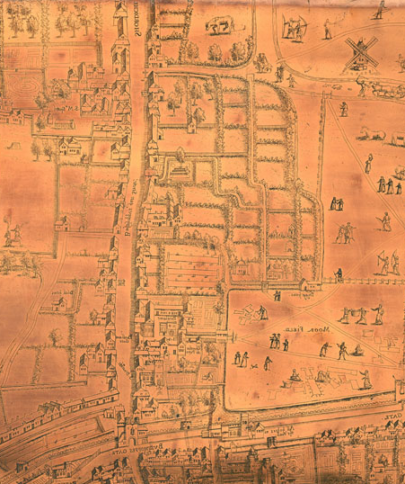
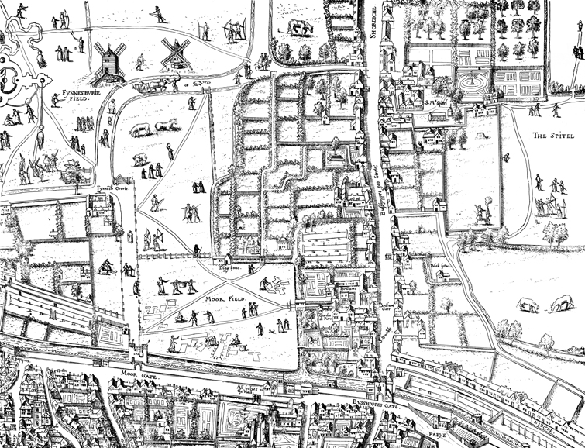
The Copperplate Map of London: 1559. © Museum of London
Notes:
The Copperplate Map; Nimrod supervising the construction of the Tower of Babel
© Museum of London
Sources: https://www.museumoflondon.org.uk/Resources/learning/targettudors/city/object.html
https://collections.museumoflondon.org.uk/online/object/104948.html
The ’Copperplate’ map is an early large-scale printed map of the City of London and its immediate environs, surveyed between 1553 and 1559, which survives only in part. It is the earliest true map of London. No printed version of the map has survived and only three plates, from an original set of 15, have been discovered.
This plate shows the area of Moorfields, Shoreditch and a small area within the City wall. The fields around London can be seen, populated by archers practising their shooting, women pegging out washing on tenter frames and people strolling by the windmills of Finsbury Fields.
The original map was probably designed for hanging on a wall, and is believed to have measured approximately 3 feet 8 inches (112 cm) high by 7 feet 5 inches (226 cm) wide. Although only a fragmentary portion of the map is known, the three plates cover the greater part of the built-up heart of the City of London.
The map takes the form of a bird’s-flight view: that is to say, the street layout and other ground features are shown in plan, as if viewed directly from above; while buildings, people and other standing features are shown as if viewed from a great height to the south of the City, but without the foreshortening of more distant features that would be necessary for a true perspective view.

Slide 7
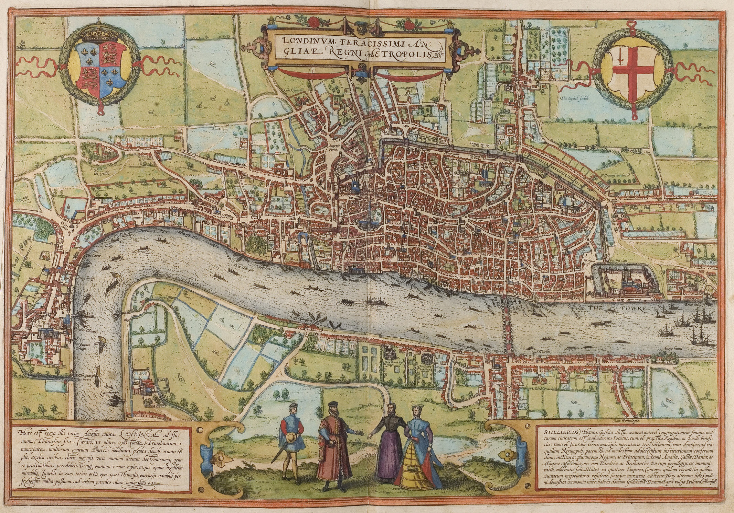
Map of London, 1572
Notes:
Braun and Hogenberg's map of London (published 1572)
Creators: Georg Braun and Frans Hogenberg
Source: Braun London UBHD - Copperplate map of London – Wikipedia
https://collections.vam.ac.uk/item/O136031/print-collection-map-unknown/
This is the earliest printed map of London. As it shows, Tudor London was much smaller than London is today. It consisted mainly of the square mile of the City of London itself, surrounded on three sides by high walls. The Tower of London was to the east and the River Thames to the south. The map covers the likely extent of the area originally covered by the full Copperplate map.
This map is from Braun and Hogenbergh's Civitates Orbis Terrarum, a six-volume work printed in Cologne from 1572 to 1617 and one of the most important works from the early days of cartography and topographical illustration. It was the first systematic depiction of cities from all over the world, containing 363 views of cities, conceived and edited by the cleric and geographer Georg Braun (1541-1622). The majority of the engravings were by Franz Hogenberg (1535-1590), who executed most of the engravings for the earlier work edited by Braun, Ortelius' Theatrum Orbis Terrarum, generally acknowledged as the first modern atlas. The English cartographer William Smith provided maps for several of the English cities; others were copied from existing views, but the artist of this view is not known. To complete the series over a hundred artists and cartographers were employed. Although the first edition of the Civitates was printed in 1572, this map must have been drawn before 1561 since it depicts the spire of St. Paul's Cathedral that was destroyed by fire that year. The four characters in the front are a standard feature of these maps, added by Georg Braun to prevent the Turks using them for military purposes since their religion forbade them looking at representations of humans.

Slide 8
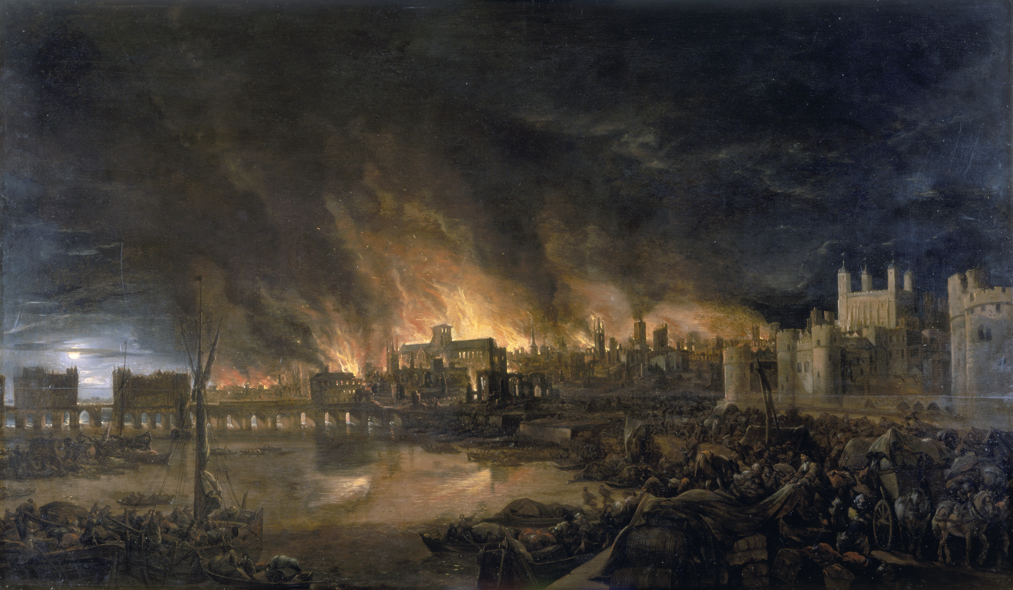
‘The Great Fire of London’ © Museum of London
Notes:
Painting of ‘The Great Fire of London’
1666-1675
Painter unknown
© Museum of London
ID: 57.54
Source: https://collections.museumoflondon.org.uk/online/object/102171.html
This painting shows a view of the Great Fire as imagined between eight and nine o'clock on the evening of Tuesday, 4 September 1666, from a boat in the vicinity of Tower Wharf. The viewpoint selected which was the safest for sketching and authentic details like the minutely observed sparks scattered high over the city, suggest that the unknown artist may have been an eye-witness of the event. This painting is unusual in that it depicts the chaos and panic in great detail.
To the left is London Bridge; to the right, the Tower of London. Old St Paul’s Cathedral is in the distance, surrounded by the tallest flames. The painting depicts Old London Bridge, various houses, a drawbridge and wooden parapet, the churches of St Dunstan-in-the-West and St Bride's, All Hallow's the Great, Old St Paul's, St Magnus the Martyr, St Lawrence Pountney, St Mary-le-Bow, St Dunstan-in-the East and Tower of London.

Slide 9
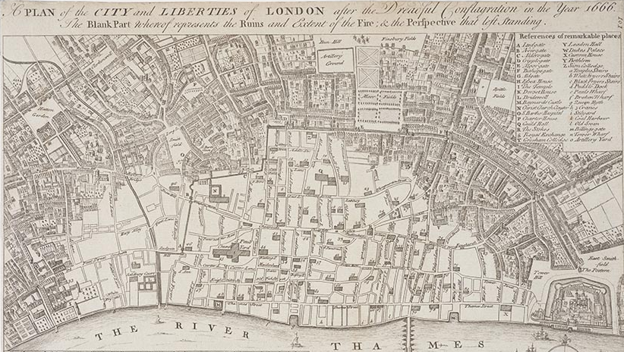
‘A Plan of the City and Liberties of London After the Dreadful Conflagration in the Year 1666’
© Museum of London
Notes:
‘A Plan of the City and Liberties of London After the Dreadful Conflagration in the Year 1666
By Wenceslaus Hollar
© Museum of London
ID: NN21098
https://collections.museumoflondon.org.uk/online/object/435893.html
This is an engraving of Wenceslaus Hollar's map of London after the fire. The white area shows the extent of the ruins - 436 acres in total (373 acres within the City walls and 63 outside). This was about one-quarter of the total size of London at the time.
Over the winter this area became the haunt of thieves. They looted the destroyed buildings and dragged passers-by into cellars, robbing them and leaving them for dead. People were afraid to go there at night. The rebuilding started in a piecemeal fashion as and when people found the money. Samuel Rolle commented in 1668 'Is London a village that I see, the houses in it stand so scatteringly?' He also noticed that people were reluctant to move into their new, isolated, homes: 'they refrain to go to them till their neighbourhood be increased'.

Slide 10
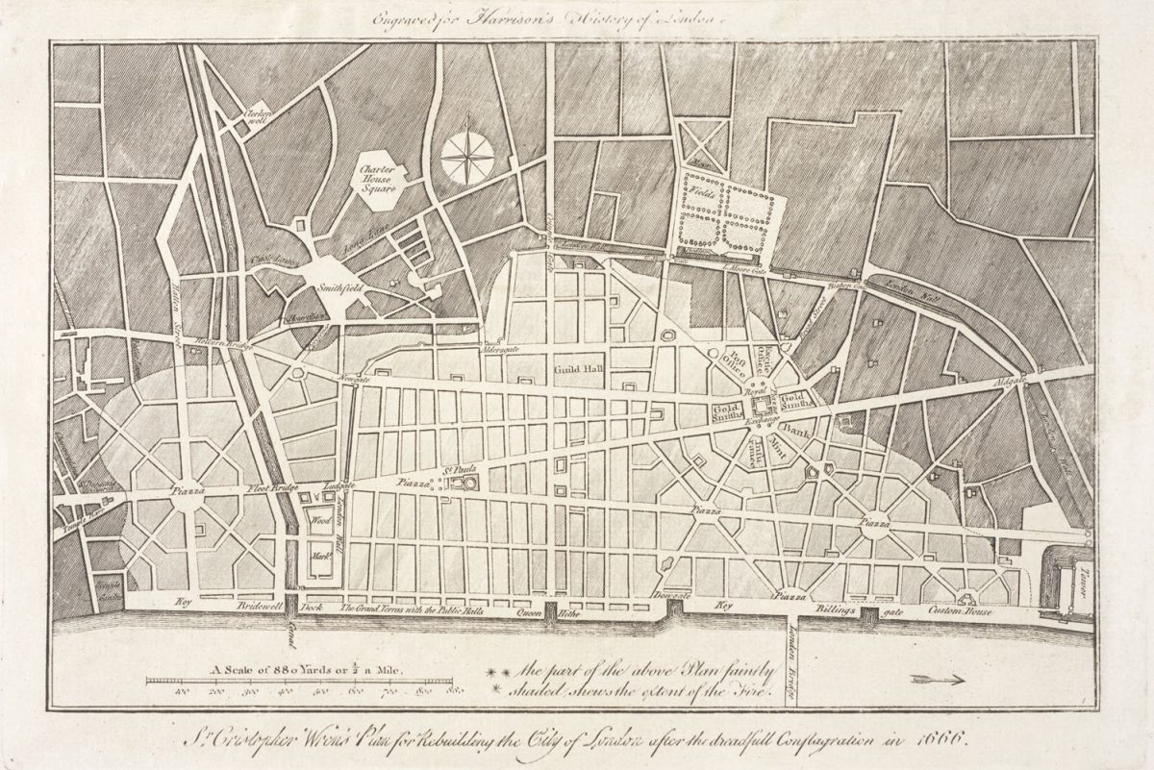
Wren's plan for rebuilding London after Great Fire of London © Museum of London
Notes:
‘Wren's plan for rebuilding London after Great Fire of London after the dreadful conflagration in 1666’
© Museum of London
Sources: https://www.bbc.com/culture/article/20160217-the-london-that-could-have-been
Just six days after the fire, Wren showed his rebuilding plan to the King, Charles II - he was among the first to submit a proposal after the catastrophe. Five different architects drew up plans to rebuild the city – none of which were followed.
Wren’s plan proposed long, wide streets, a canal for the Fleet River, a straight quayside and large squares. The buildings were in neat blocks, while the narrow streets that had helped spread the fires have been replaced by monumental avenues radiating from piazzas. Two diagonal boulevards cut across a grid of handsome, stone-fronted streets leading to and from a grand new Royal Exchange and an imposing new St Paul’s Cathedral. These two buildings would have been the Roman basilica and temple of their day.
Wren’s design was never built but some elements of it were used, such as improvements to the quayside by the Thames.

Slide 11
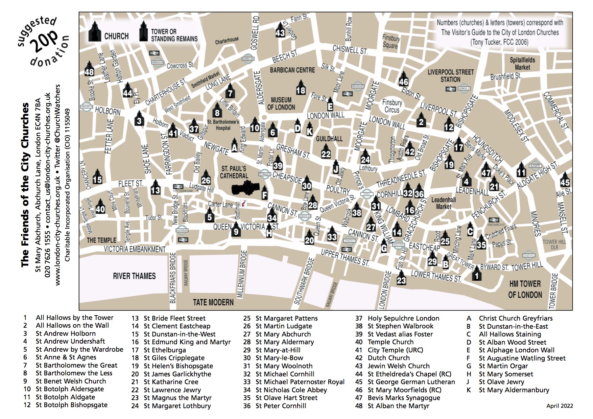
© Friends of the City Churches
Notes:
City Churches of the Square Mile
Source: https://www.london-city-churches.org.uk/map_of_churches.html
This map shows the 48 churches in the City of London today.
There were 110 parish churches, as well as Livery Company, civic and private chapels, in the City in 1666; 80 were destroyed in the Great Fire, of which 51 were subsequently rebuilt under the direction of Sir Christopher Wren and his office. Some 48 survive today within or near the boundaries of the modern City of London. Together they illustrate an extraordinary breadth of architectural history from the magnificent Norman Choir of St Bartholomew the Great and humble St Ethelburga, through the unusual transitional design of St Katharine Cree of the 1630s, to Wren's classical masterpieces, Nicholas Hawksmoor's St Mary Woolnoth and the late Georgian Gothic Revival of St Bartholomew the Less and St Dunstan-in-the-West.

Slide 12
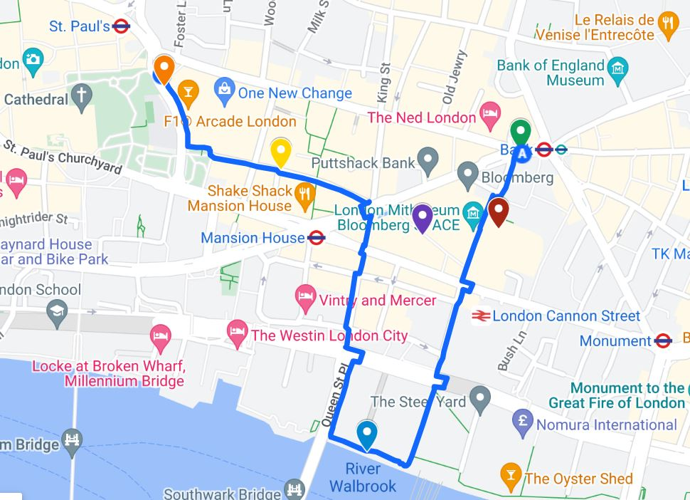
Bank Station
St Stephen Walbrook
Mithraeum
River Thames
Watling Street
One New Change
Our walking route
Notes:
London today: our walking route and stopping point for BUILDING LONDON: ROMANS, WREN AND LONDON TODAY
Source: Google Maps
We recommend using Google Earth and other online mapping resources to look at the City of London area and put it in context of your own local area.

Slide 13
BUILDING LONDON: ROMANS, WREN AND LONDON TODAY
We recommend teachers use www.layersoflondon.org Google Earth or other online mapping resources with their pupils, to look at the City of London area, and to put the location of the City into context with their own local area.
Please let us know what you did in class after your visit. We’d love to see any work inspired by your visit.

